Slide 1


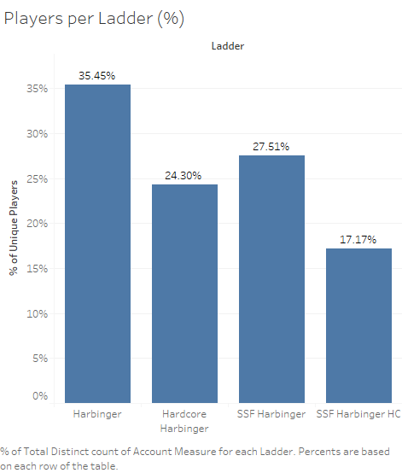
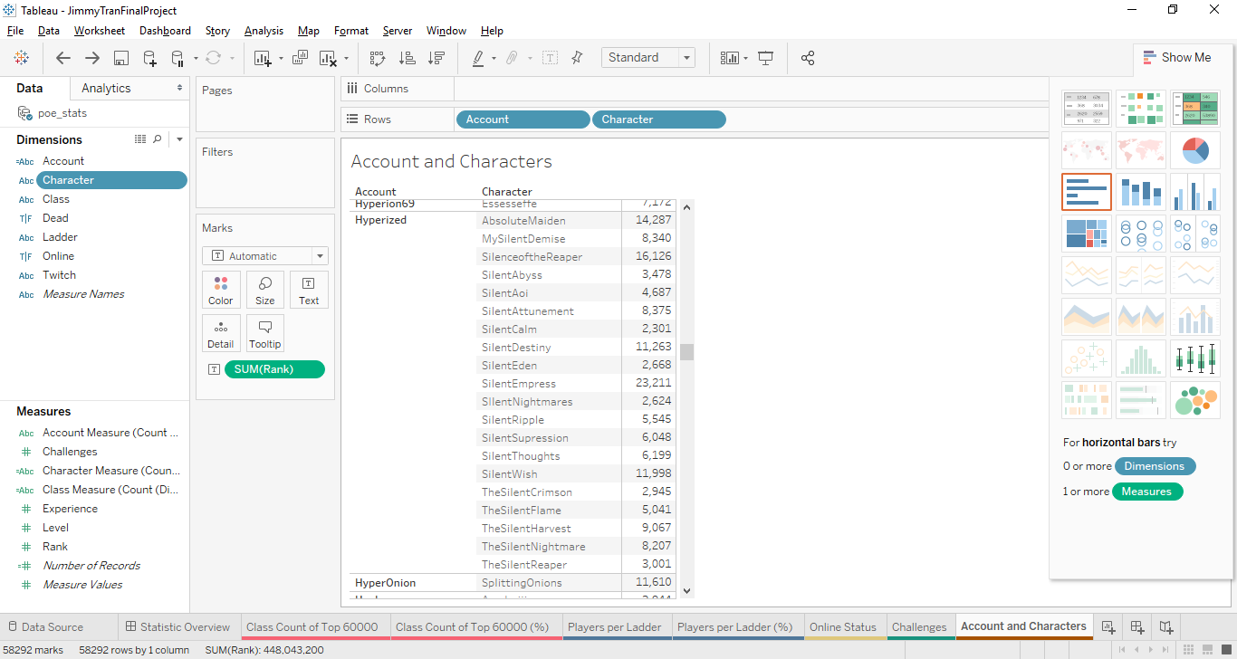
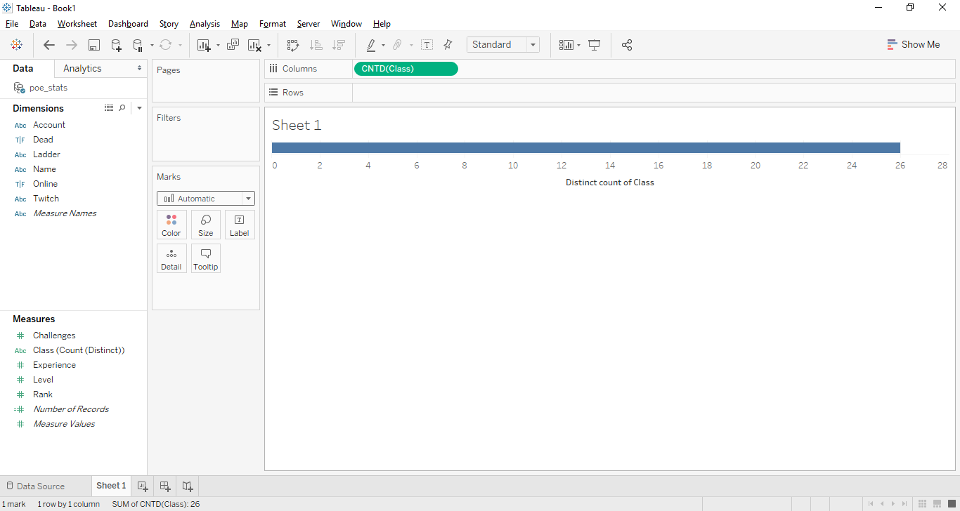
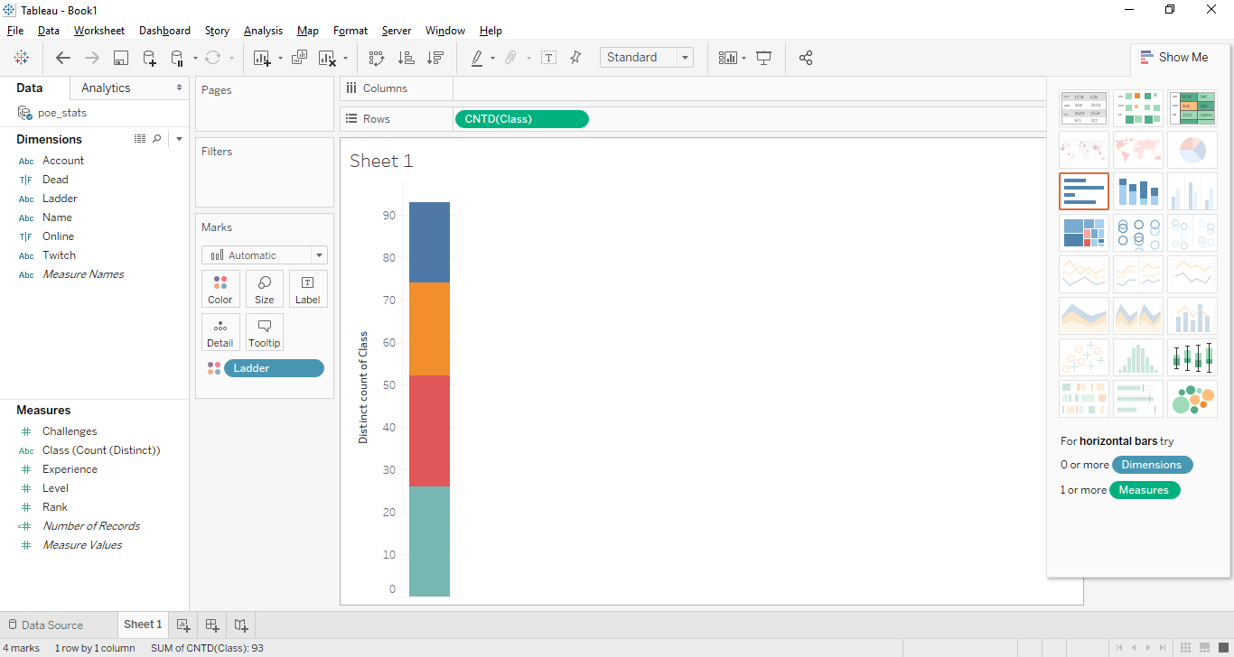
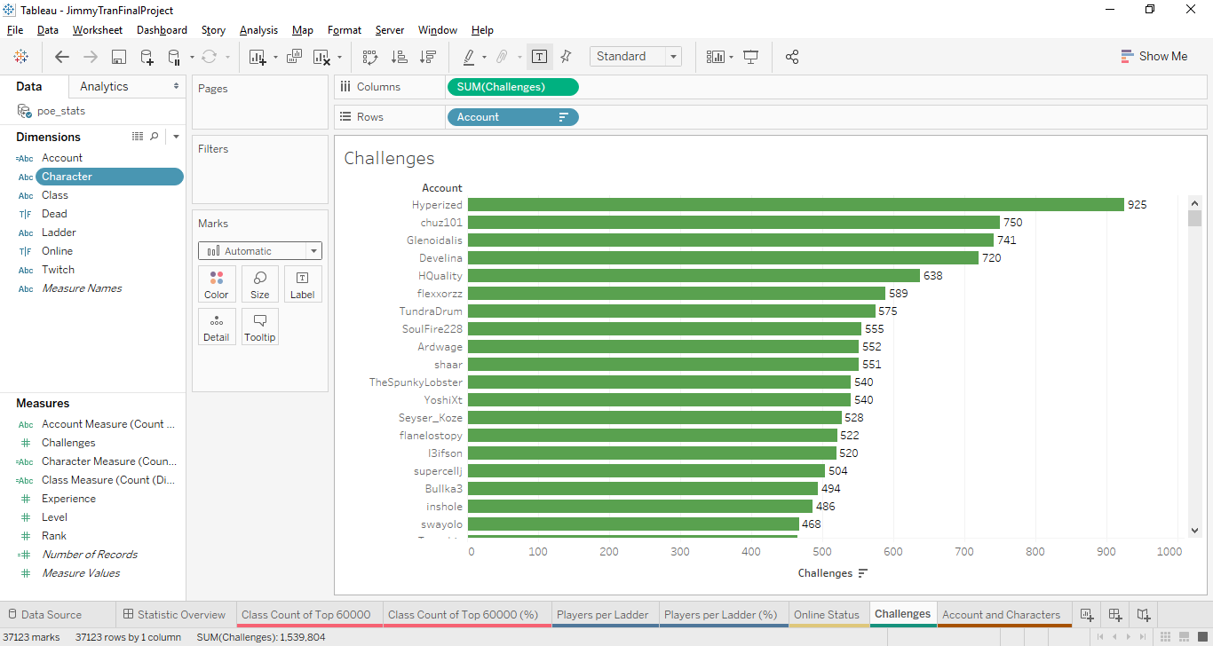
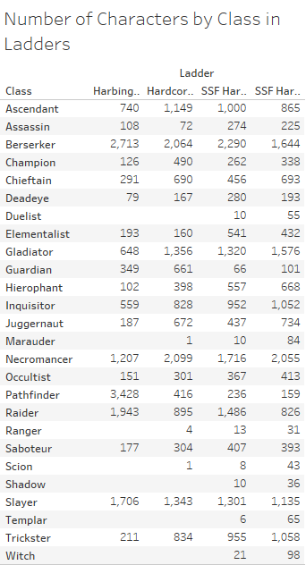
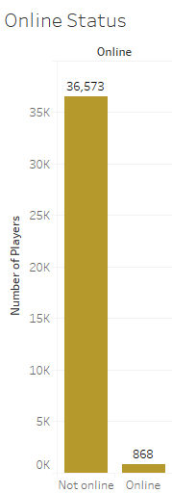
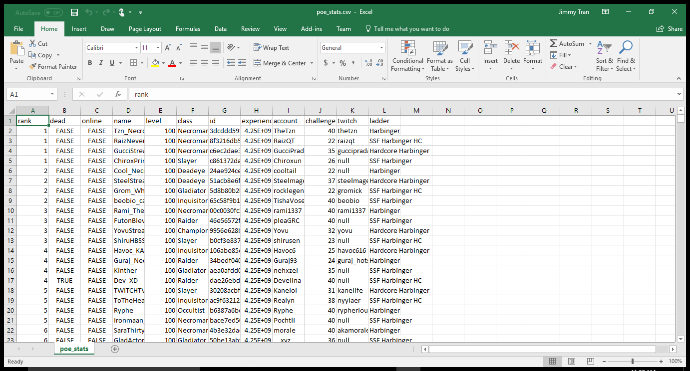
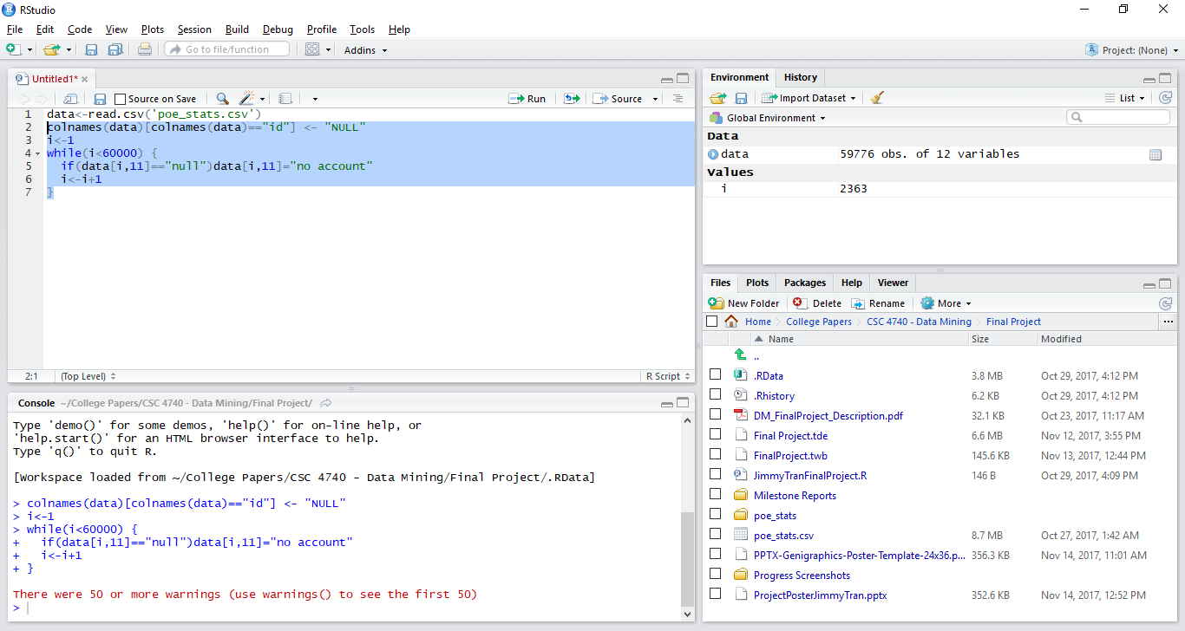
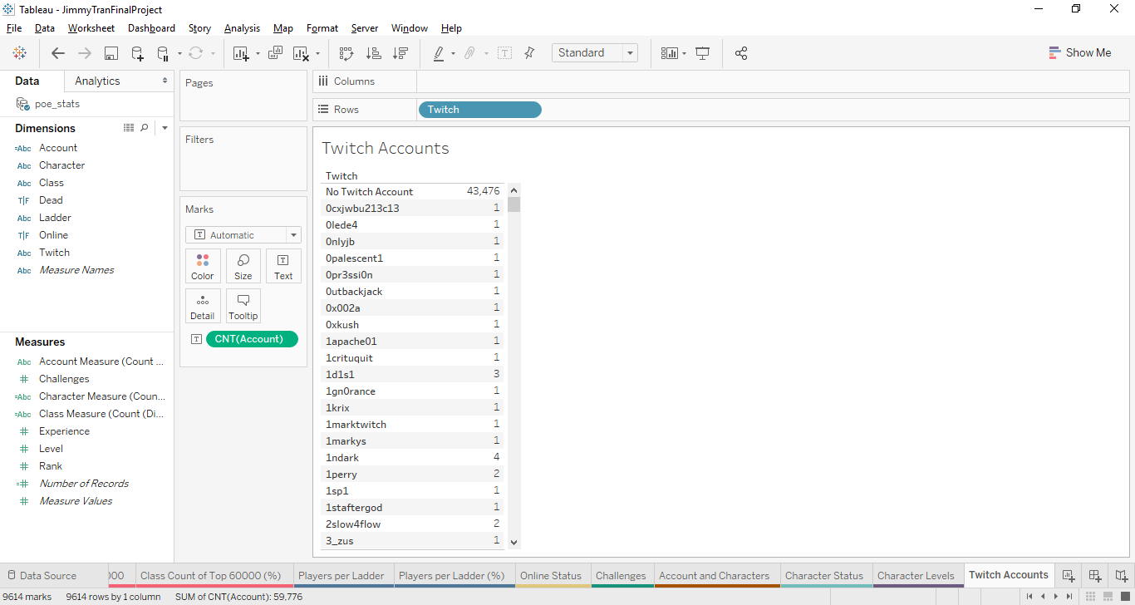
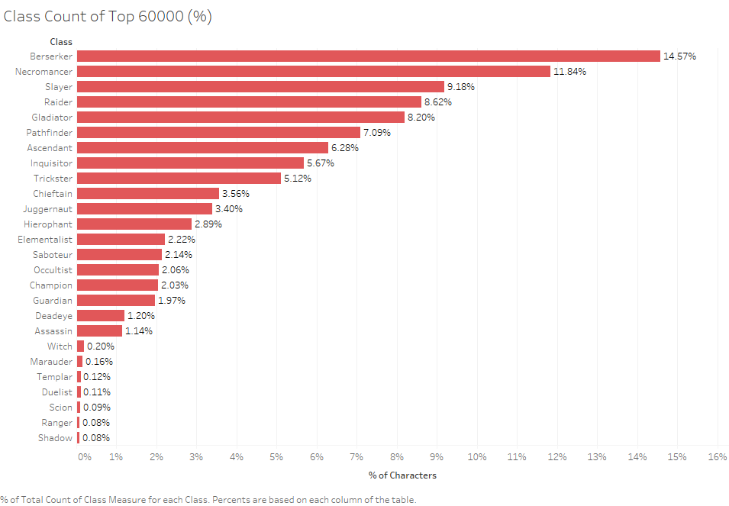
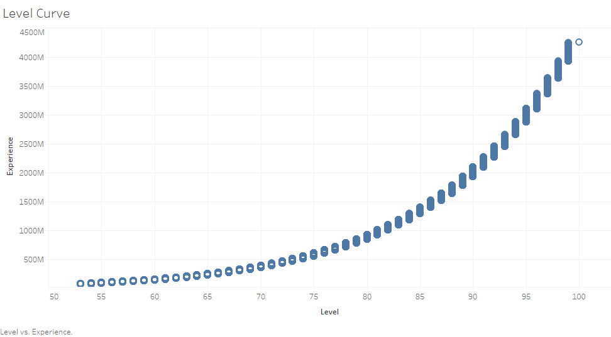
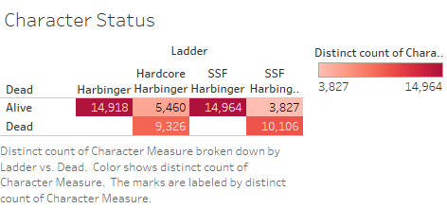
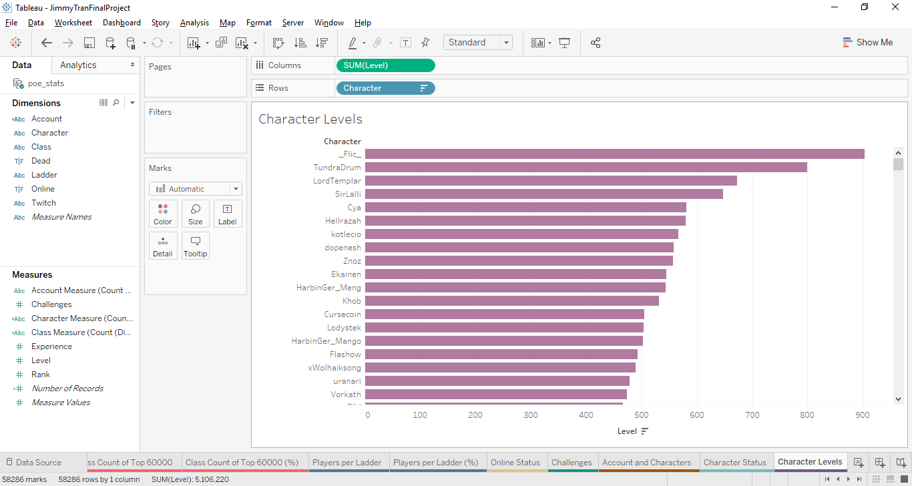
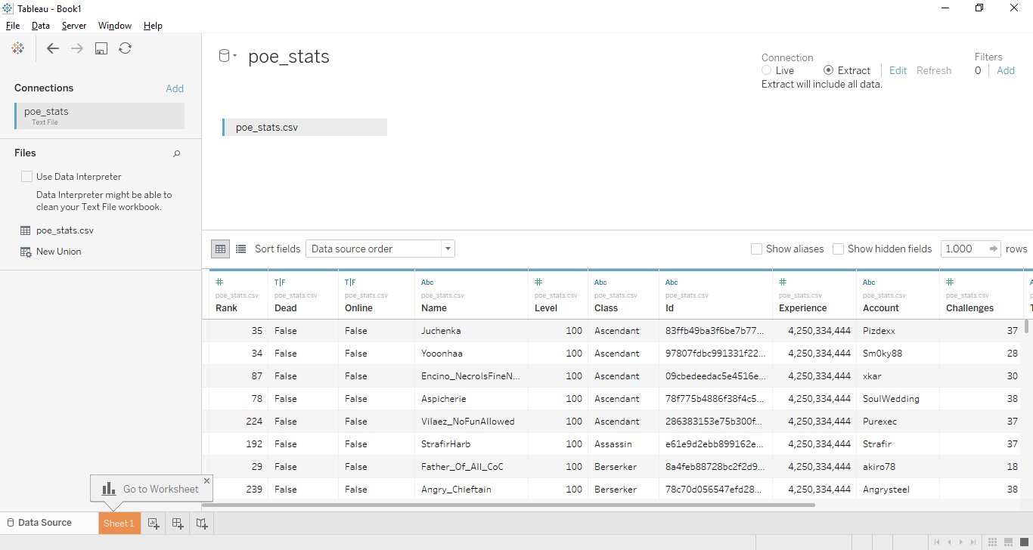
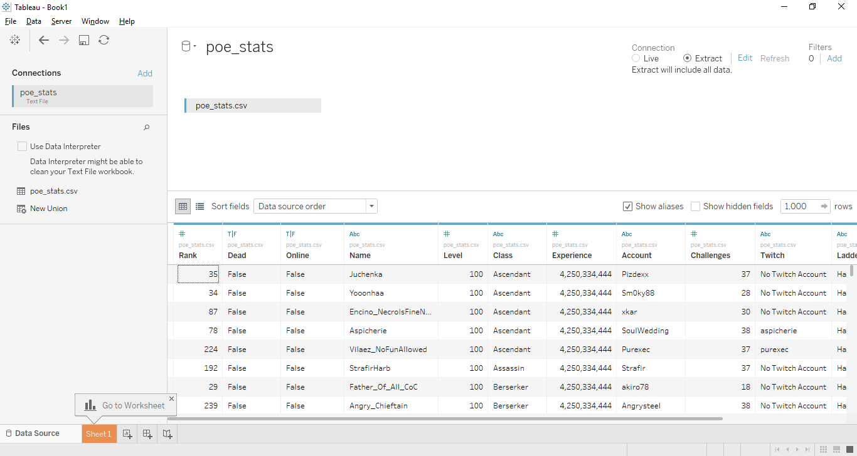
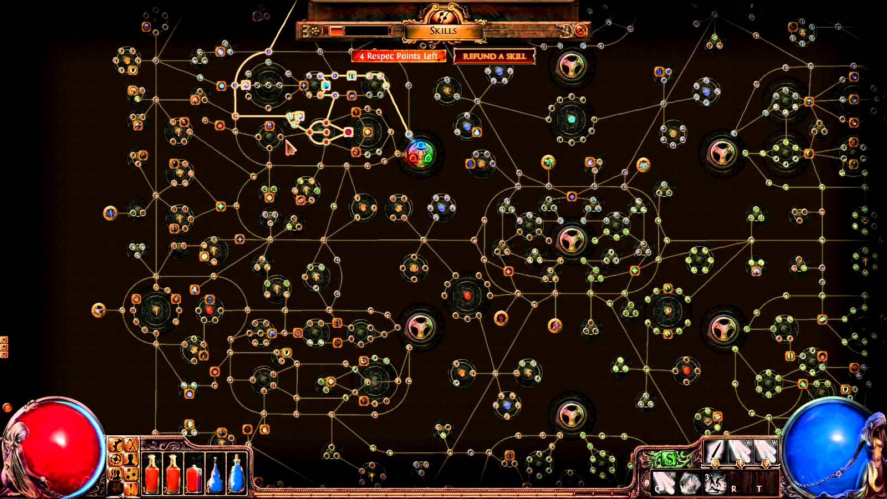
Path of Exile Leaderboard Analysis – October 26, 2017
Jimmy Tran
^{Georgia State University}
1. Overview and Problem
3. Initial Tableau Plotting and Issues
Originally, I decided on using a dataset about possible Poker hands and the odds of winning with those hands. The simplicity of the data coupled with the extensive math involved turned me away from that though.
As a result, I switched to a dataset about a popular free-to-play massively multiplayer online game called Path of Exile (Figure 1). The data set in question comes from a website called Kaggle and focuses on the top 60000 players on the PoE leaderboards as of October 26, 2017. A link is provided here to that dataset although it may or may not be updated as of recent due to constant daily changes in the PoE leaderboards.
Link: https://www.kaggle.com/gagazet/path-of-exile-league-statistic/data
Problem Statement: I mostly want to see if there is an issue with class balance in PoE. Another issue is how many of the top players care for the hardcore ladders.
Goal: While generally not an issue when playing for fun, if one class dominates the competitive leaderboards, the developers need to rebalance them. Also, if there is not much participation, they may need to offer more incentive to care about them.
With pseudo-cleaning complete, attempts to create the first plot began. As can be discerned from the given images (Figures 5 and 6), this did not tide over well either. Working with dimensions and measures sounded odd given how much time I spent with R. I was not going back to R though, so I continued with Tableau and eventually got a good result.
Chart 8. Hyperized seems to play a bit too much.
Figure 5. What is a measure?
Figure 6. Another bad plot.
Chart 5. Percentage of players involved in each ladder. Note that it is possible for a player to be in multiple ladders.
4. Successful Plotting with Attribute Conversions
I fiddled around with converting attributes between dimensions and measures for about an hour until the first successful plot was achieved. From there, the process is all downhill as plotting dimensions against themselves as a measure (primarily count and distinct count) worked out a good percentage of the time. A few plots are just duplicates since I wanted to display the percentages rather than the raw numbers (not present on this poster because of lack of space) but there is a fair amount of data that I gleaned from my plots even if a PoE outsider has no clue what he/she is looking at. In some cases, I used program screenshots instead of an exported .png file as I am sure no one wants a 30000 pixel anything.
Chart 9. Did I say “a bit”? I meant he probably needs a life.
Figure 1. The initial data viewed in Excel.
Figure 2. Attempts to clean in R end in failure.
2. Cleaning Process
Initial cleaning attempts were based in R script (Figure 2). Twenty minutes after beginning though, I realized that would not end well at all and I also questioned whether I had to technically clean my data since I could simply ignore the attributes in question anyway.
At this point, I imported my data, conveniently in the form of a .csv file, into Tableau (Figure 3). With no issues arising from the import, I also realized I could actually hide unwanted attributes or change the names of null values by providing an alias. The actual data would not be affected either, only the front-end would be changed and visible. Suffice to say, I saved a lot of time skipping the R cleaning process (Figure 4).
Chart 6. More detailed numbers for Chart 5. This shows class breakdown.
Chart 7. Online status of players at the time the data was mined.
Chart 10. Twitch accounts. I could not quite get this to display right but the math should be obvious since the count for “No Twitch account” is there.
Chart 1. Percentage of characters created by class. Berserker is more popular than necromancer? What is this nonsense?
Chart 3. Level curve. Kinda glad I never played to 100. Exponential experience requirement is ugh.
5. Conclusions
It seems there is an issue with the Necromancer and Berserker classes almost dominating the ladders (Chart 1). The lower six classes are understandable as they are base classes only used to begin the game.
Hardcore participation is about expected in comparison to the normal ladders from my point of view. I expected about a 66/33% split between the two normal and two hardcore ladders. SSF hardcore could probably stand to gain some popularity.
Personal notes: I enjoyed seeing the data of the leaderboards of Path of Exile in a better format. It definitely put some things into better perspective for me personally. Would have liked to have data mined the passive skill tree (see below), but that would take forever (and it gets altered every few months or so).
Chart 2. Character status by ladder. Harbinger and SSF Harbinger can be disregarded as characters cannot permanently die in those ladders.
Chart 4. Level cap increase or hackers? Last I checked the cap was 100.
Figure 3. Data before cleaning in Tableau
Figure 4. Data after cleaning in Tableau
Contact
References
Jimmy Tran
Georgia State University
Email: jtran25@student.gsu.edu
Phone: 678-644-2270
Kaggle: https://www.kaggle.com/gagazet/path-of-exile-league-statistic/data
Path of Exile Website: https://www.pathofexile.com/faq

